Slide 1

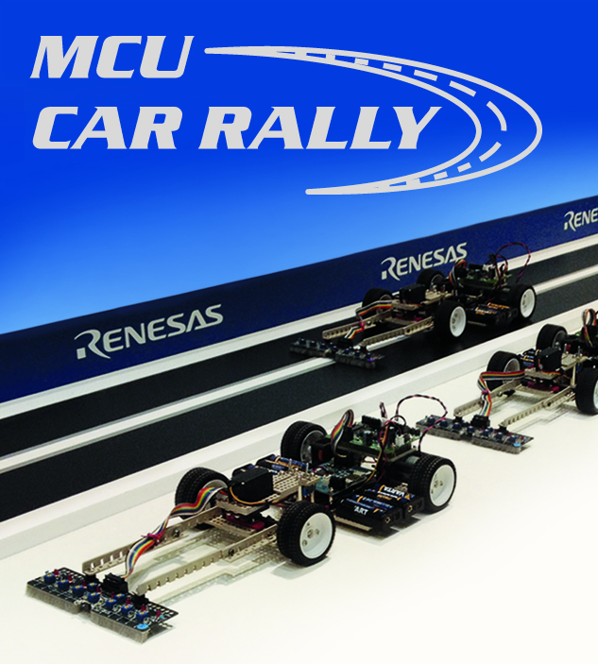
Renesas MCU Car Rally 2018
Faculty of Computing, Engineering and Science
University of South Wales – 2017/18
MEng Group Project
USW Team
Students:
13013521 Thomas Brown – MEng Electrical and Electronic Engineering
15021106 Kayin Templar– MEng Electrical and Electronic Engineering
14031329 Miguel Santos – MEng Computer Systems Engineering
Lecturer:
Prof Gouping Liu

Slide 2
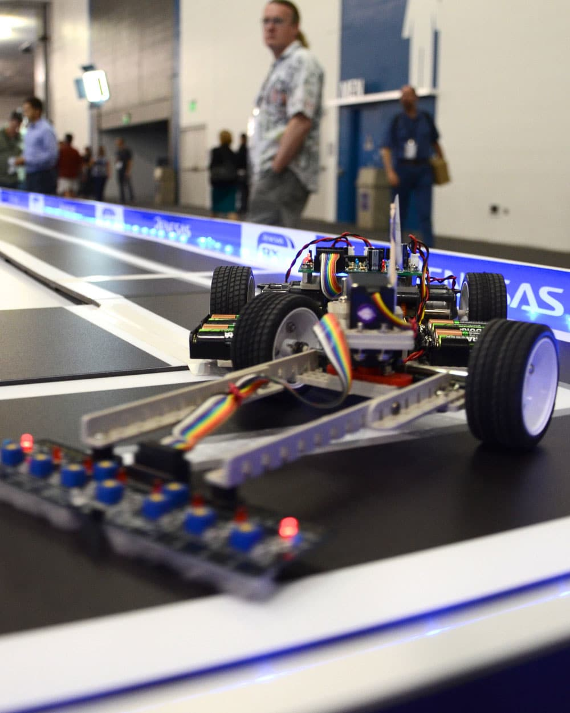
Outline
Overview
Project goals
Core features
The car
Mechanical
Electrical
Control theory
Software
Peripherals and drivers
Car controller
Extra features
MEng Group Project – Renesas MCU Car Rally 2017/18

Slide 3
Outline (cont.)
Project output
Performance
Problems and solutions
Discussions and conclusion
MEng Group Project – Renesas MCU Car Rally 2017/18

Slide 4
Overview
Every year, the University of South Wales allows its students to participate in a competition organised by Renesas.
In this competition, students race each other with an autonomous car built from parts provided by Renesas. One of these parts include a special microcontroller – the RX62G and RX62N.
This presentation is the feedback of that same project for the USW Team.
MEng Group Project – Renesas MCU Car Rally 2017/18

Slide 5
Project goals
Besides aiming for first place, our focus was mainly to:
Improve last year’s car performance, both on the same old car and on a brand new car.
Build a new (better) car.
Innovate and optimise on the algorithms and controls used to control the car.
MEng Group Project – Renesas MCU Car Rally 2017/18

Slide 6
Core features
Many features were proposed and implemented for the past months. Some were discarded, while others contributed to the final project outcome.
Some of the major features:
Mechanical
Lower height
Weight slightly distributed at the back
Increased the length of the car
Electrical
Designed a board to accommodate accelerometer, Bluetooth and a very simple battery charge sensor using a resistor network
Designed a speed sensor using two hall effect sensors next to the wheels
Software
This time, the system is using a proper full PID system as opposed to a PD system from previous year
The algorithm is fully implemented with RTOS
Full-duplex communication with Bluetooth – allows real-time debug and control of the car with smartphone or computer
Intelligent and dynamic algorithms for control – machine learning
MEng Group Project – Renesas MCU Car Rally 2017/18

Slide 7
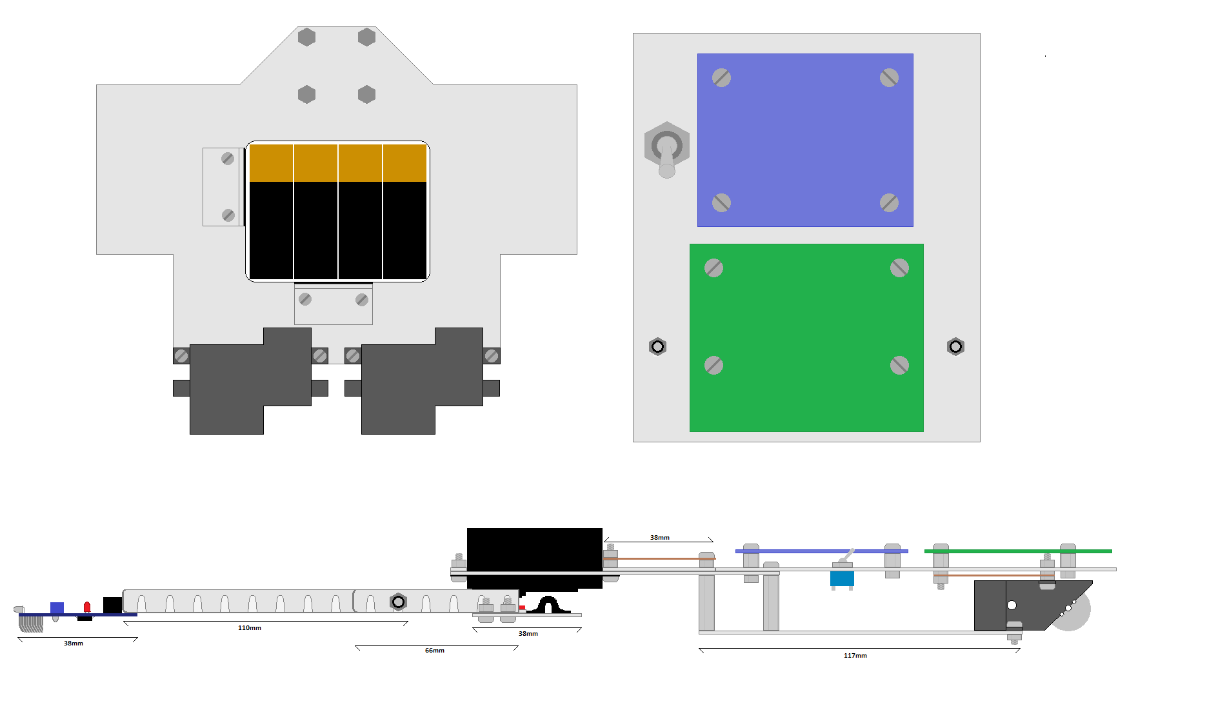
The car - Mechanical
MEng Group Project – Renesas MCU Car Rally 2017/18

Slide 8
The car - Mechanical
<Kayin – Add your slides here>
MEng Group Project – Renesas MCU Car Rally 2017/18

Slide 9
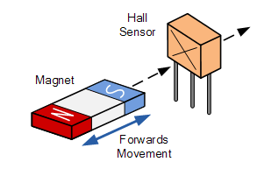
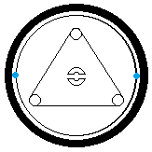
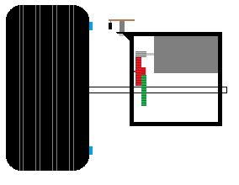
The car - Electrical
Hall Effect Sensor
Speed Control
A hall effect sensor gives a signal that represents the presence of a magnetic field.
Magnets glues to the rear wheels produce a rotating magnetic field.
3. Was attached above the gearbox as close to the wheel as possible.
Hall effect sensor
Magnet
MEng Group Project – Renesas MCU Car Rally 2017/18

Slide 10
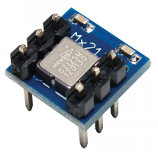
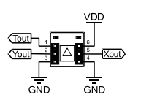
The car - Electrical
Accelerometer
Speed and Acceleration Control
Secondary method of speed control.
Also used for braking and acceleration feedback.
Two axis accelerometer sends two PWM signals to MCU board.
MEng Group Project – Renesas MCU Car Rally 2017/18

Slide 11
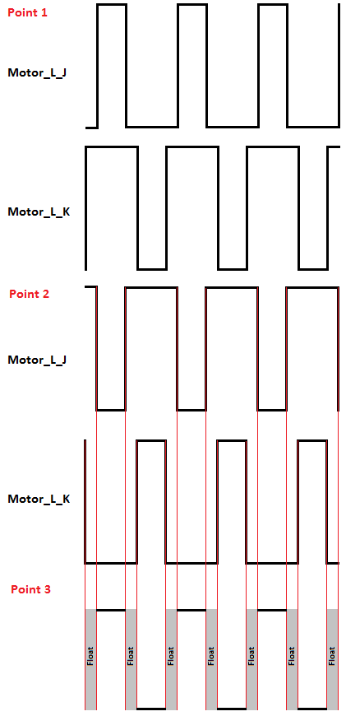
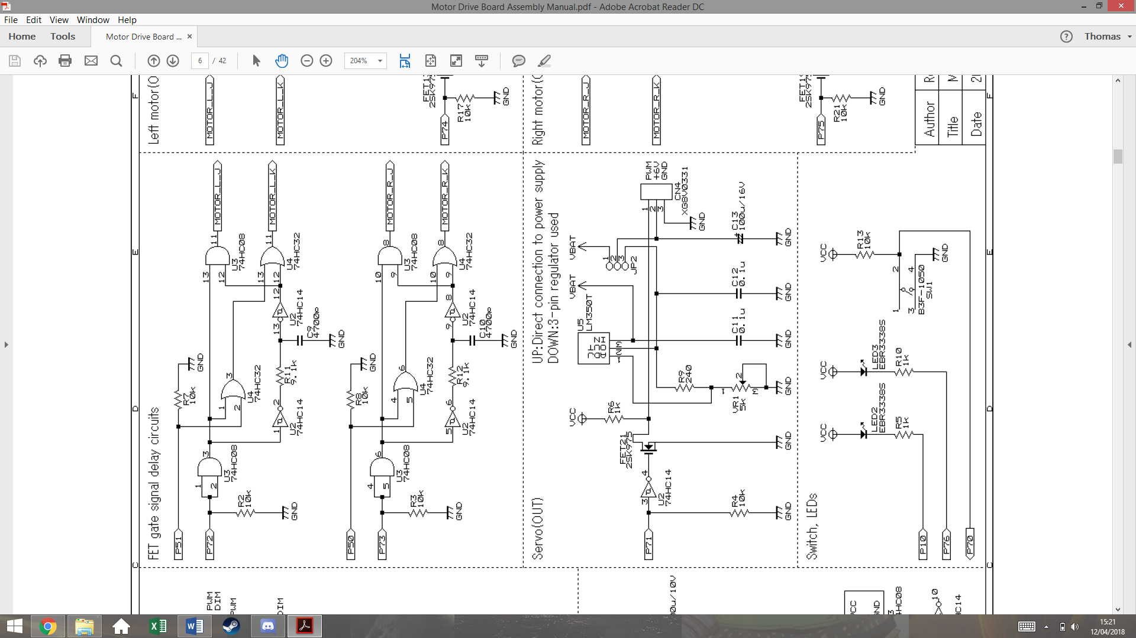
The car - Electrical
Power Board
Delay Circuit
MEng Group Project – Renesas MCU Car Rally 2017/18

Slide 12
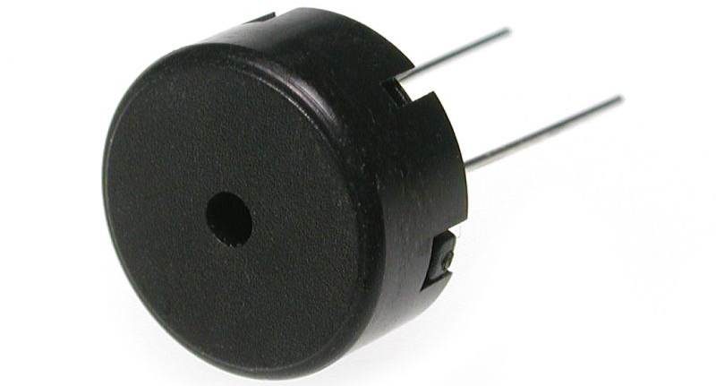
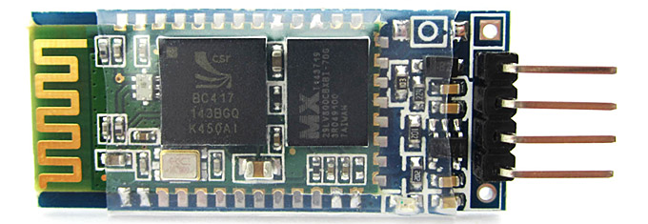
The car - Electrical
Other peripherals
Piezoelectric Buzzer - Used for signalling start-up, errors etc.
Bluetooth Transceiver - Used for live commands and debugging.
Voltage Divider - Used to sense battery voltage level.
MEng Group Project – Renesas MCU Car Rally 2017/18

Slide 13
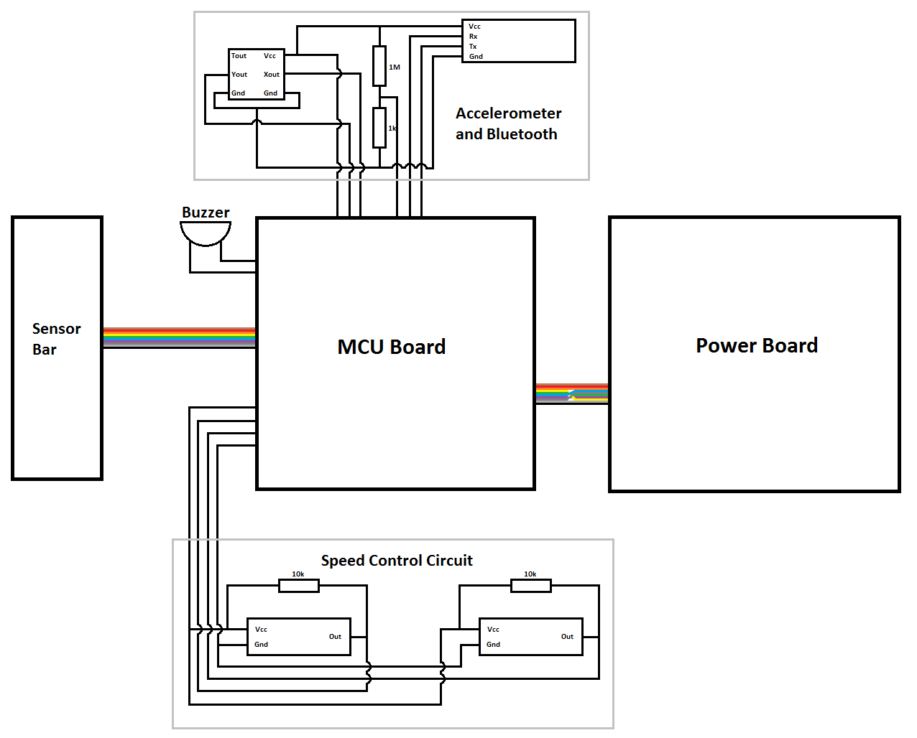
MEng Group Project – Renesas MCU Car Rally 2017/18

Slide 14
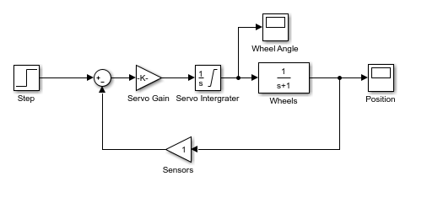
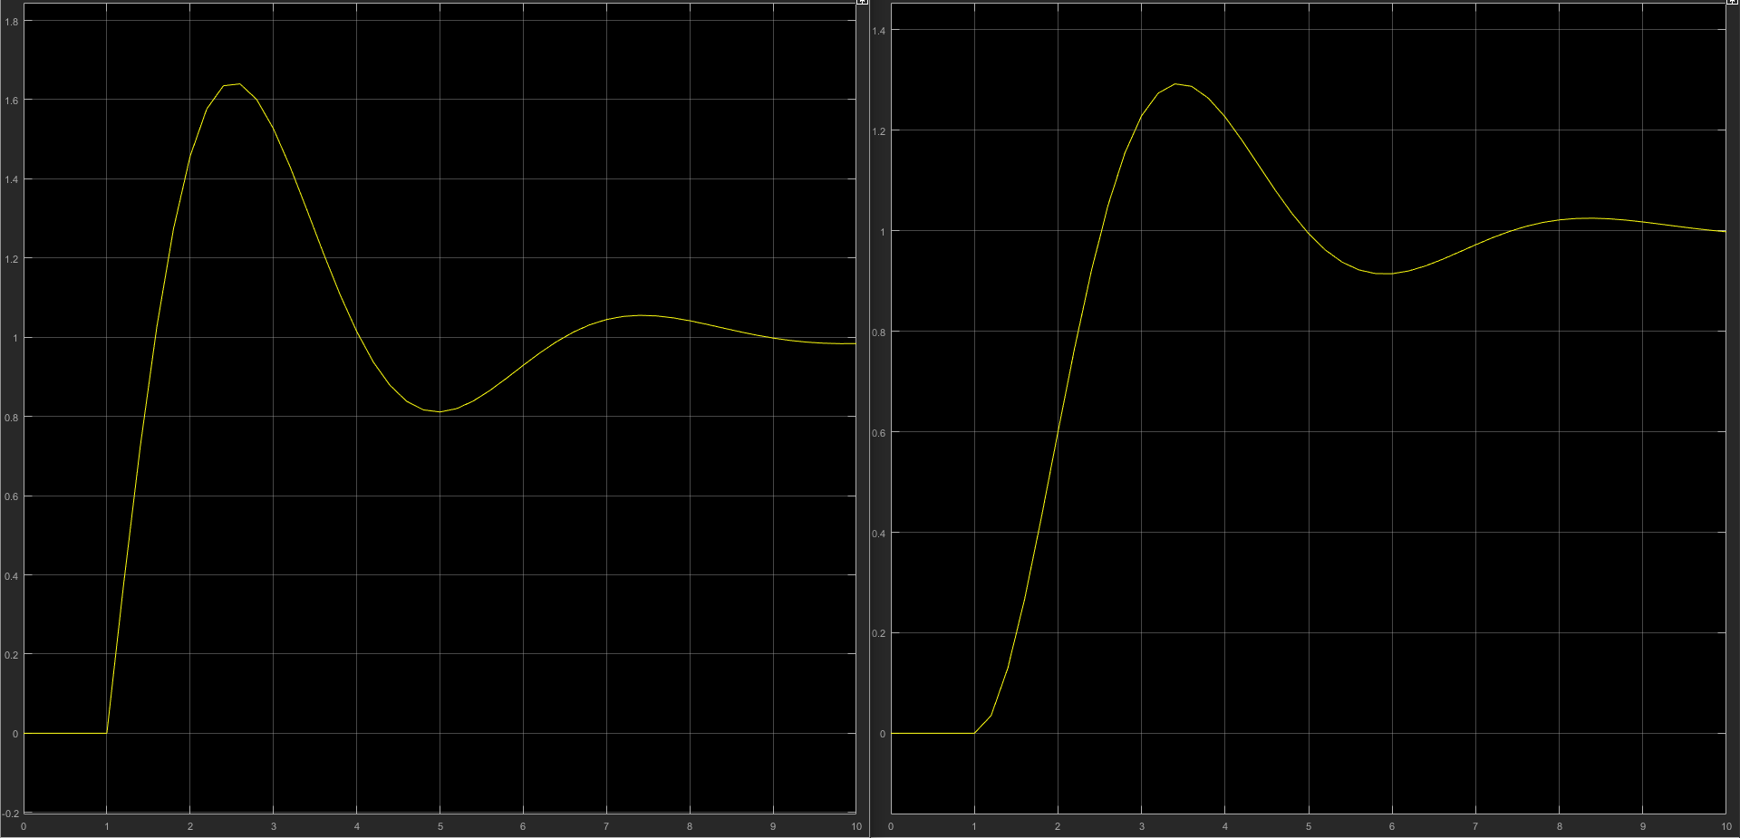
The car – Control theory
PID Transfer functions
The Modelling of position control
MATLAB was used to create the most accurate model
The servo has both a gain (to convert PWM to an angle demand) and an integrator.
2. The position of the wheels will feature both integration and a frequency dependent component.
3. The response to a basic closed loop system of this is shown here.
MEng Group Project – Renesas MCU Car Rally 2017/18

Slide 15
The car - Software
The software was developed by creating portable, separate independent modules.
Each module has its own submodule.
(e.g. Motor module contains SPWM module and MIDI player contains piezo buzzer module which contains SPWM module).
They use the microcontroller’s resources through RTOS.
They are:
Frontend/user software
Car controller.
Interactive command line (shell).
Backend software
Micrium uCOS III (RTOS).
Drivers for peripherals.
Communication protocols.
MEng Group Project – Renesas MCU Car Rally 2017/18

Slide 16
The car – Software – Peripherals and drivers
Several C drivers were created:
Motors
Servo
Line tracker/sensor board
Hall effect sensor
Accelerometer
Bluetooth
Piezo buzzer
These belong to the backend side of the program, and are used by the user application together with RTOS.
MEng Group Project – Renesas MCU Car Rally 2017/18

Slide 17
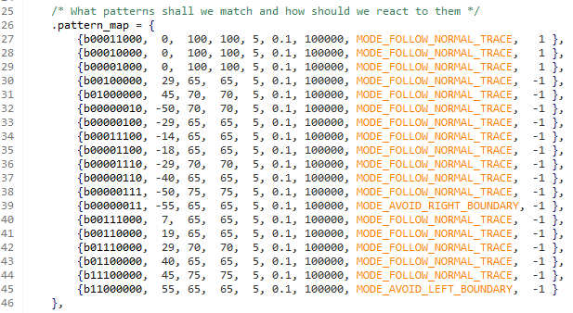
The car – Software – Car controller
(Coming back to the PID controller…)
The car reads and interprets the patterns listed on the right
It then translates those values into an approximation of the desired/target angle
That approximated value is the feedback of the PID system
MEng Group Project – Renesas MCU Car Rally 2017/18

Slide 18
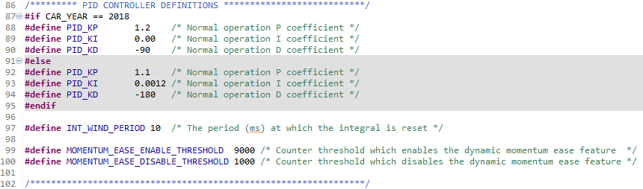
The car – Software – Car controller
The tuned PID coefficients are found below:
MEng Group Project – Renesas MCU Car Rally 2017/18

Slide 19
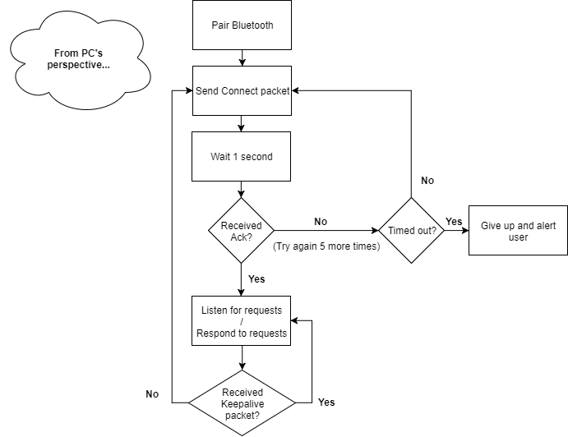
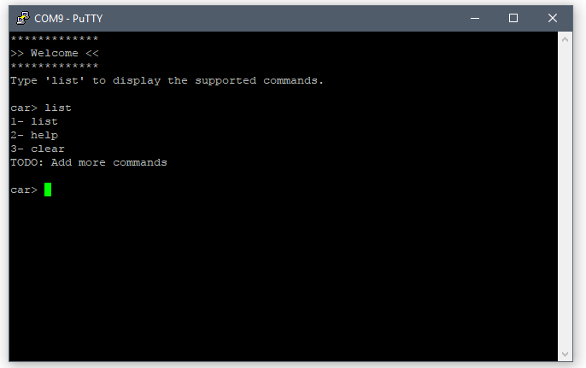
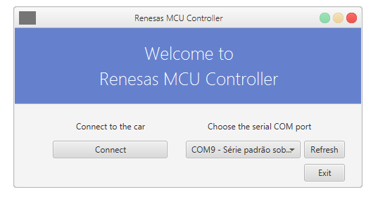
The car – Software – Extra features
Interactive shell
Seamless and robust layered communication protocol
Improved PWM duty cycle accuracy
MEng Group Project – Renesas MCU Car Rally 2017/18

Slide 20
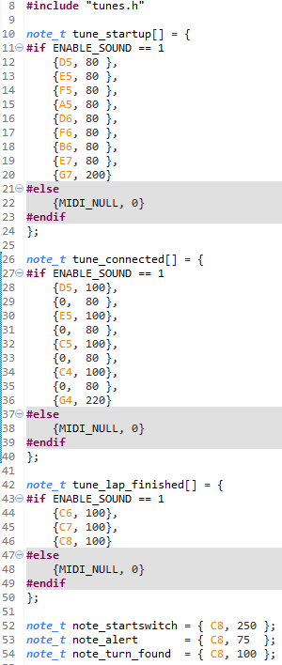

The car – Software – Extra features
Multiple levels of control intelligence (basic, advanced and smart)
MIDI player
Wireless firmware deployment (bootloader)
Backward and forward compatibility with older and future cars
MEng Group Project – Renesas MCU Car Rally 2017/18

Slide 21
Project output
(Demonstration video)
MEng Group Project – Renesas MCU Car Rally 2017/18

Slide 22
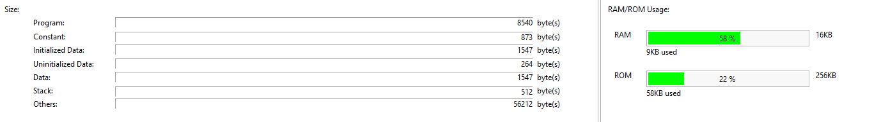
Performance
On the software side:
Memory usage:
Program size: 50,820 bytes (50.82 KB)
ROM usage: 58 KB / 256 KB = 22%
RAM usage: 9 KB / 16 KB = 58%
Maximum RPM = ~1600 RPM
Nominal velocity = ~1.73 m/s at 80% PWM duty cycle and with high torque gears
Romania’s car (1st place): ~2.06 m/s (unknown PWM duty cycle)
Germany’s car (2nd place): ~1.61 m/s (unknown PWM duty cycle)
MEng Group Project – Renesas MCU Car Rally 2017/18

Slide 23
Problems and solutions
Problem 1: the accelerometer output wire broke off, thus making it impossible to determine momentum.
Solution: use a counter together with the RPM sensor to predict the momentum.
Problem 2: the car loses stability at high speeds.
Solution: slow down the car dynamically according to the pattern detected on the sensor board.
Problem 3: the car easily comes out of the track even while braking.
Solution: replace the (yellow) gear with a (red) gear that has higher torque.
MEng Group Project – Renesas MCU Car Rally 2017/18

Slide 24
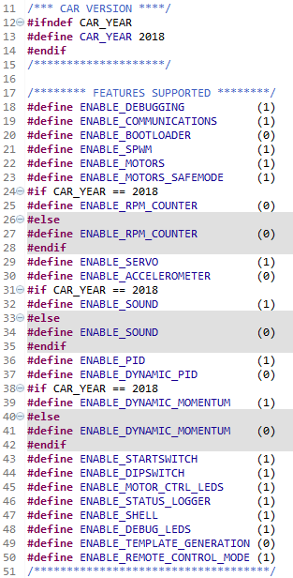
Problems and solutions
Problem 4: the microcontroller’s CPU lacked processing resources.
Solution: multiplex the “heavy” operations, such as floating point calculations.
Problem 5: not enough RAM memory.
Solution: move constant data values into the ROM memory, optimise the size of the arrays and use C macros to enable and disable features.
MEng Group Project – Renesas MCU Car Rally 2017/18

Slide 25
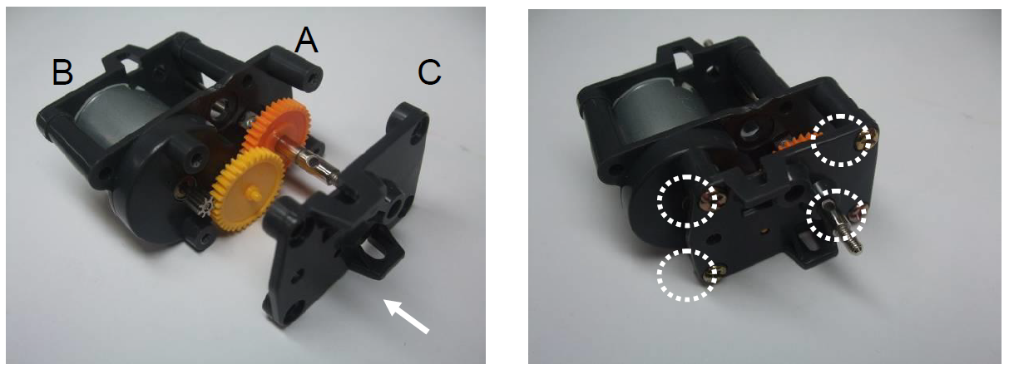
Problems and solutions
Other known problems:
Lack of battery charge seems to affect the performance quite dramatically. When the voltage drops on the servo, its response time and travel speed is lowered considerably. In addition, the motor’s current draw would cause the voltage on the MCU to drop to a certain level consequently resetting it.
The gearbox seemed to have a design fault, where the gear would create friction with the top of the gearbox thus preventing the motor from rotating. This event occurred mainly when the motors were set to 100% PWM duty cycle. The solution was to shave the top of the gearbox on the outside allowing the yellow/red gear’s tip to come out of the plastic.
MEng Group Project – Renesas MCU Car Rally 2017/18

Slide 26
Discussions and conclusion
According to the data, it would’ve been possible to reach 2nd place in ideal conditions.
This is considering that:
The motors were limited at 80% duty cycle
The high torque gears limit the maximum speed
The weight does not favour the stability (extra momentum = harder to control)
The motors brake constantly due to the impossibility of measuring momentum
The tests and measurements were mainly done with half charged batteries
Despite the fact that we did not compete this year, this project was still a success, because we:
Improved last year’s car
Built an improved car
Innovated on the algorithms
Conclusion: we have achieved all project goals.
MEng Group Project – Renesas MCU Car Rally 2017/18

Slide 27
Questions?

